Slide 1
Search for a doubly charged Higgs decaying to muons or electrons: Prospects for CMS Run III
IMSAloquium
April 19, 2023
Gautham Anne
On behalf of the IMSA-CMS group

Slide 2
Goals of This Talk
Explore the doubly charged Higgs (H++)
Models
Production Mechanisms
Signal
H++ event signature
Signal channels
Background
Estimation
Estimated limits on the H++
Future Work
Automatic Datacard Generation
Punzi Sensitivity Approximation

Slide 3
Doubly Charged Higgs
Left-Right Symmetric model
Parity violation in the weak sector
The LRS model predicts a Higgs triplet
Neutral Higgs (not the SM Higgs)
Singly Charged Higgs
Doubly Charged Higgs

Slide 4
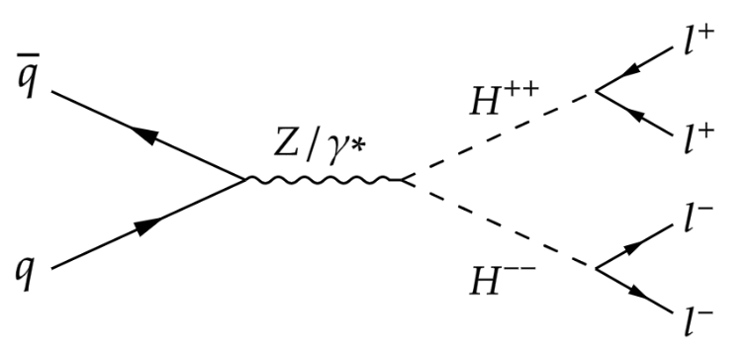
Doubly Charged Higgs Production
A pair of oppositely charged doubly charged Higgs can be produced by a Z boson or electro-weak production
Higgs couples with any massive particle

Slide 5
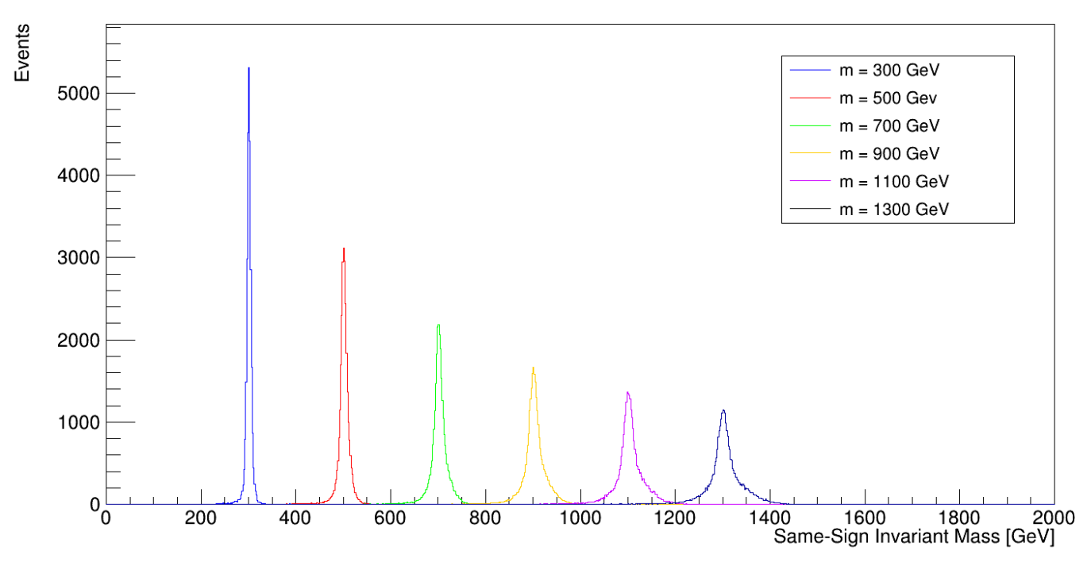
Event Signature: Same Sign Dileptons (SSDL)
The H++ can produce a pair of leptons with the same charge
A H++ event will produce a total of 4 leptons split into same-sign pairs
This is a very rare signature in pp collisions
Notes:
Decay is constrained by charge. There is potential to also decay in Ws but nothing else.

Slide 6
A Different Approach to Estimating Background
Our background has an incredibly small cross section and comes from primarily from systematic errors
Charge mismeasurement and photon fakes combined account for 75 ± 16.324%
In order to estimate such background a different method is required from the usual
The efficiency is too low
Monte Carlo (count how many events pass cuts) is worse for low frequency phenomenon
Numerical estimate
Notes:
Mention that this is not necessarily a novel idea.

Slide 7
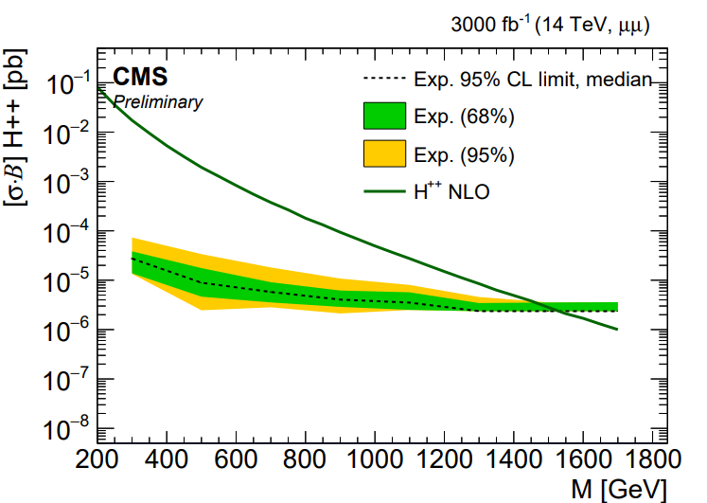
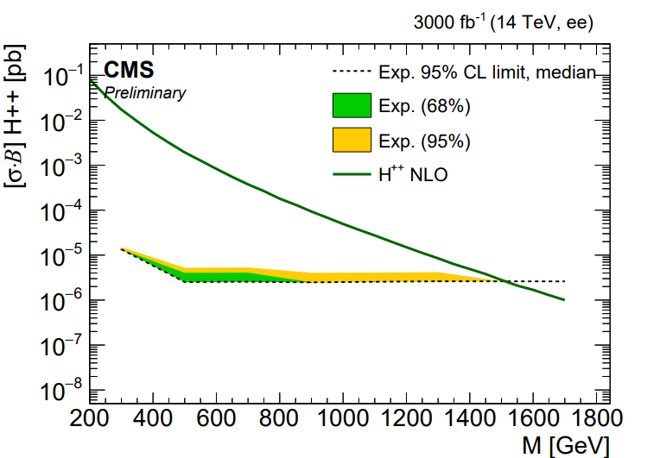
Estimated Limits
Estimated limits for the HL-LHC
Scaling by 1/√(luminosity)
Estimated Run III limits:
1300 GeV, ee
1325 GeV, uu

Slide 8
Automatic Datacard Generation
Datacards
Encodes observed and expected events after event selection
Distinguishes between signal vs. background
Manual setting of datacards
Human error
Time consuming
Developed framework for automatic datacard generation
Created H++ analysis object
Channel
Make a txt file with channel name
Process
Yields + systematics
Higgs Combine Tool
Runs thousands of pseudoexperiments based off datacards
Returns the limit on the Higgs

Slide 9
Automatic Datacard Generation
Datacards
Encodes observed and expected events after event selection
Distinguishes between Signal vs. Background
Manual setting of datacards
Human error
Time consuming
Developed framework for automatic datacard generation
Created H++ Analysis Object
Channel
Make a txt file with channel name
Process
Yields + systematics
Higgs Combine Tool
Runs thousands of pseudoexperiments based off datacards
Returns the limit on the Higgs

Slide 10
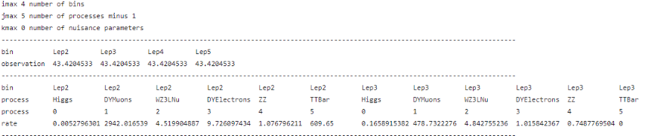
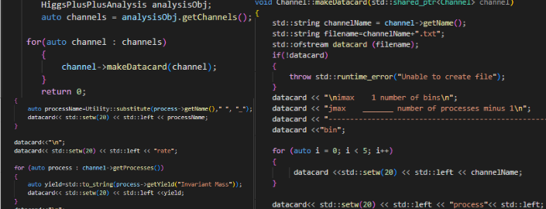
Example Datacard

Slide 11
Definition: Sensitivity
Helps us determine what point to employ a cut
Reduce background to better identify signal
Can’t cut out too much signal in the process
Example for H++
Background: QCD, Drell-Yan, Ttbar, BLAHHHHHHHH
PUT PICTURE FOR QUALITATIVE ANALYSIS OF CUT SELCECTION

Slide 12
Sensitivity Estimation
Our group’s selection cuts were based on the standard significance = S/sqrt(B) formulation
Flaws
Depends on a-priori expectations of limit settings
Punzi Criterion
Independent of a-priori expectations to assert that a discovery has been made
Derived simple approximation of Poisson counts with background

Slide 13
Derivation: Definitions
X – Observed variable, H_0 – distribution of X
H_m is Poisson distribution of X with mean equal to the number of B+S_m
S_m new signal, m the unknown free parameter of the signal
Test H_0 by selecting range of X that helps us reject H_0
Critical Region
Alpha is the significance level of rejecting H_0 when it is indeed true
Alpha = 5 sigma

Slide 14


Derivation: Criteria
Independent of choice of metric
In both observable and parameter space
Should not require a choice of priors and independent of expectation of signal
Priors are assumptions we make about signal
and

Slide 15
Derivation: Some Assumptions
S_m is non-zero
n>n_min
S_m >S_min

Slide 16


Derivation
Using a gaussian (ask dr dong if should be capitalized, weird convo) of the Poisson, we can state that
Assume efficiency of signal cuts are independent of m, that is and we aim to maximize sensitivity by minimizing sigma_m

Slide 17



Derivation and Comparison
Setting a = b = 5sigma, we arrive at
Consider the common sensitivity measures:
and
First expression cannot be calculated unless cross section of signal is known, and not directly related to significance of search, but rather the uncertainties in measurements of yields and new processes
Second expression
Linear in S, but breaks down at small values of B
If efficiencies are unknown

Slide 18
Some Limitations
Cannot replace sensitivity search with full-likelihood approach
Only for optimization of analysis at early-stages of cut selection
Assumes a counting experiment and neglects systematics

Slide 19
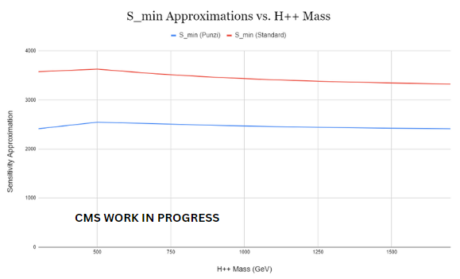

Slide 20
Future Work
Background estimates
Photon fakes
Charge mismeasurement
Addressing other background sources
Implement systematics into datacard generator
Implement

Slide 21
Acknowledgements
Dr. Peter Dong, IMSA
Paul Karchin, Wayne State University
Lenny Spiegel, Fermilab
SIR Department at IMSA
Fermilab
CMS
CERN

